Slide 1
High-Level Architecture Review Session
EPIC
Enterprise Pipeline for Infrastructure and Cloud
Travis Hayes / Robb Morgan
Senior Manager, IT Architecture / IT Solutions Engineer
Architectural Peer Review performed: 06/08/2026
Notes:
Make it more friendly sounding – sharing more than review – Architecture Peer Presentation – Can we make it less scary

Slide 2


EPIC: Enterprise Pipeline for Infrastructure and Cloud
Virtual Meeting Safety
Know Your Safety Protocols
Share Your Location in Chat
Assign a 30/30 Lead
Ensure Proper Ergonomics
Know Your Evacuation Plan
I’m cared for as a human being
People have my back
I know new ideas are safe to try
I’m not attacked for my ideas
Active Shooter “Get Out/ Hide Out/Take Out”
Earthquake
“Drop/Cover/Hold”
Psychological Safety
Call the Nurse Care Line for any discomfort at 1-888-449-7787
See Something / Say Something: Leader, HR or Compliance and Ethics Hotline 1-888-231-2310

Slide 3
EPIC: Enterprise Pipeline for Infrastructure and Cloud
Agenda
Safety, Goals, and Ground Rules | 5 minutes | Michael Hansen
Problem Statement | 5 minutes | Travis Hayes
Key Requirements Impacting Design | 5 minutes | Robb Morgan
Target State / High-Level Architecture Review | 20 minutes | Robb Morgan
Concerns/Follow-Ups | 5 minutes | Michael Hansen
Notes:
Add Safety and groundrules

Slide 4




EPIC: Enterprise Pipeline for Infrastructure and Cloud
Ground Rules
Out of respect for your busy schedules and the material that we need to review, we will be sticking to the schedule as outlined. Please minimize interruptions of the presenter and rest assured that we will gather concerns at the end of the session.
We are here to help everyone build better solutions. It takes a lot of confidence and humility to stand in front over 100+ people and showcase your work. Let’s support each other and build each other up.
On Time & On Purpose
Be Supportive
We want to make peer reviews efficient and effective. To achieve this balance, we ask that you let the SA present their architecture. However, we do not want you to forget your concerns. All architecture questions from chat will be followed-up by the SA after the session.
You will notice that this Peer Review has no “Board” and no approval process. This is simply a place to engage your colleagues in technical learning, collaboration, and continuous improvement.
Ask Questions (in chat)
We Are Here To Learn
Notes:
No approve. There no board

Slide 5


EPIC: Enterprise Pipeline for Infrastructure and Cloud
Problem Statement
PG&E does not have an enterprise CI/CD pipeline that can support multi and hybrid cloud. As a result, teams independently adopt and configure CI/CD tools and patterns, creating inconsistent controls, unpredictable cost, increased operational risk, and uneven developer experience across the enterprise.
Inconsistent Delivery and Developer Experience
Increased Regulatory and Operational Risk
Higher Enterprise Cost and Complexity
Governance, approvals, and audit controls are implemented inconsistently across teams
Production stability and recovery capability vary by application and pipeline design
Compliance relies on individual team discipline rather than enforced enterprise controls
Teams use different pipeline patterns, controls, and release processes
Developer onboarding and productivity vary significantly by applications and teams
Enterprise DevSecOps improvements are complex to roll out consistently
Inconsistent pipelines creates duplicated integrations and support models for support
Existing pipelines tools and skills do not support multi & hybrid cloud world
De-centralized model creates duplication of effort with minimal enterprise value

Slide 6
EPIC: Enterprise Pipeline for Infrastructure and Cloud
Key Requirements Impacting the Design
Key Functional Requirements
Universal Pipeline — one ADO framework adopted by every PG&E app team. As a regulated utility, consistent security, audit, and governance controls are mandatory across every workload — not optional per-team choices.
Single contract per app — every team onboards via .pipeline/epic.json; the contract drives stage selection (Build · Test · Scan · Infra · Deploy · Integration) and infrastructure provisioning.
Multi-cloud deployment — one pipeline targets AWS, Azure, Azure Local, and SAP BTP based on cloud.* in the contract.
Self-service runs + automated CI — users trigger builds from the EPIC dashboard, and PR merges to tracked branches kick off CI automatically.
Per-app, per-environment infrastructure — Terraform .infra/ provisioned through reusable pgetech/epic-pipeline-modules.
Key Non-Functional Requirements
Security — mandatory Wiz / SonarQube scans · AWS Secrets Manager for all creds · no long-lived cloud keys on agents.
Auditability / FinOps — every Engine build tagged: epicRepo · epicAppName · epicAppType · epicEnvironment · epicCloud.
Governance & SoD — ManualValidation@0 approval gate driven by approvalEnvironments[] per environment.
Maintainability — centralized orchestrator + engine + stage templates; one repo to fix, every team benefits.
Network compliance — internal ALB w/ PG&E corp CIDR ingress · CCOE-managed VPC · private Route 53 zones.

Slide 7
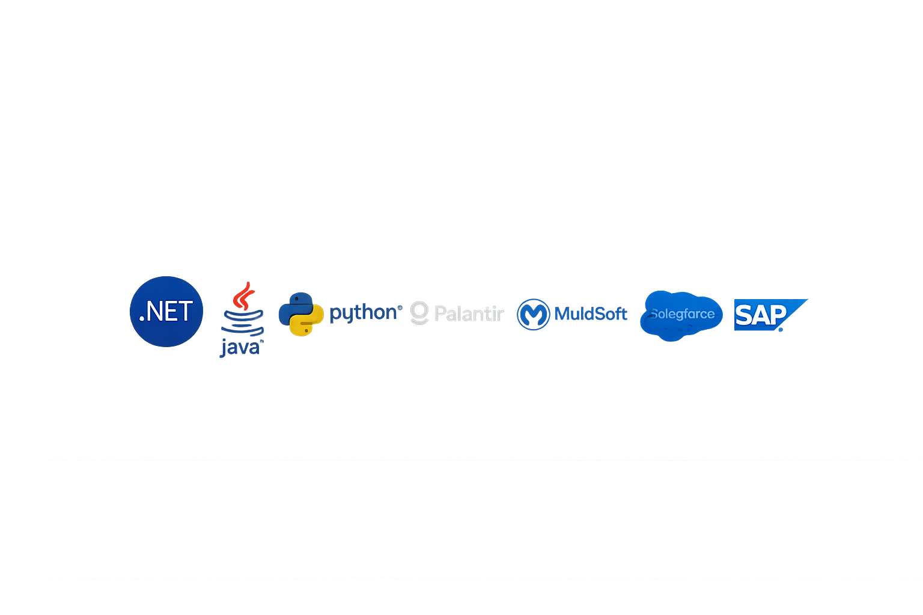
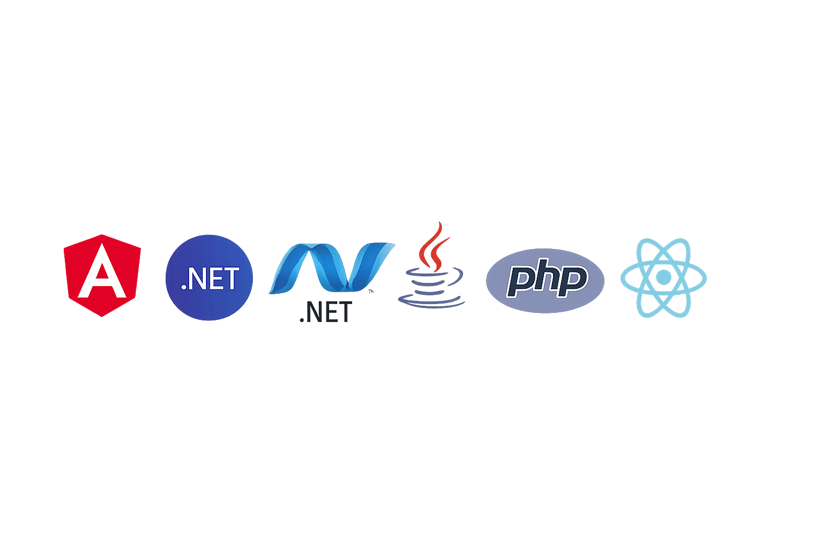
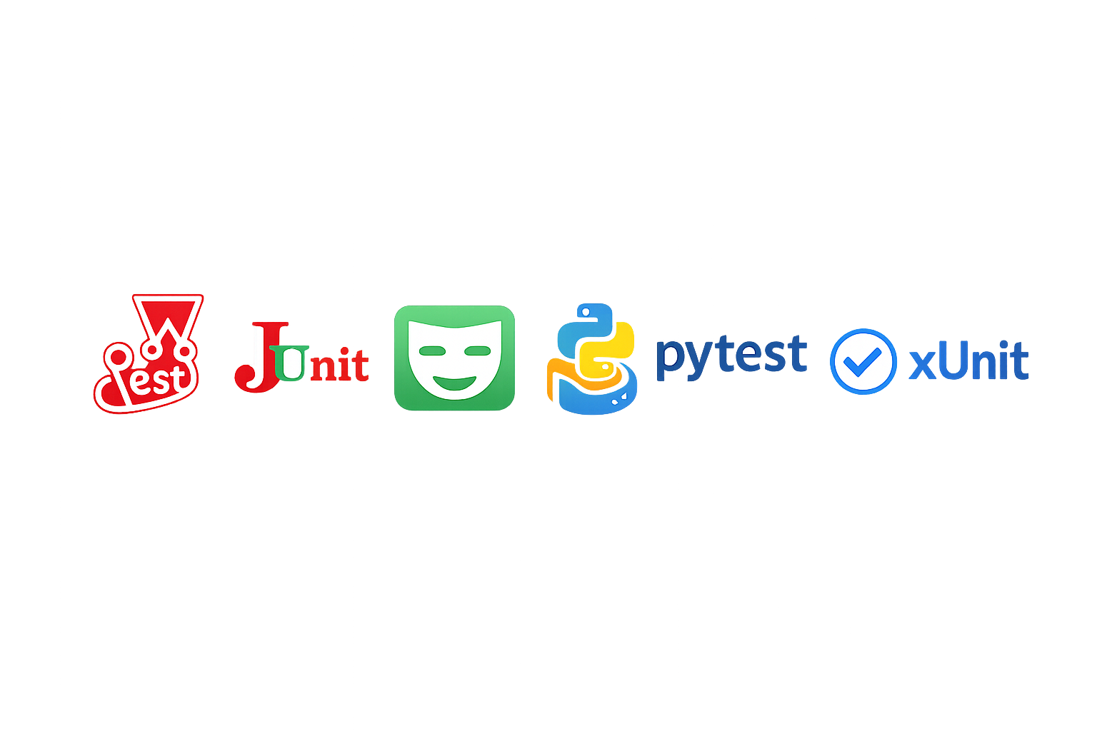




EPIC: Enterprise Pipeline for Infrastructure and Cloud
Target State: Universal Pipeline Across Platforms
Build Pipeline Configuration
Create pipeline config in project repo
Enterprise Pipeline
Pass
Fail
Approve
Denu
App - Build
Unit Tests
App - Scan
Infra - Deploy
(optional)
App - Deploy
Run Integration Tests (optional)
Business Outcomes
Faster Delivery
Reduced Risk
Consistent Architecture
Audit-Ready by Default
Reduce Technical Debt
“Enterprise Pipeline transforms developers intent into secure, compliant cloud deployments – automatically, consistently, and at enterprise scale.”

Slide 8
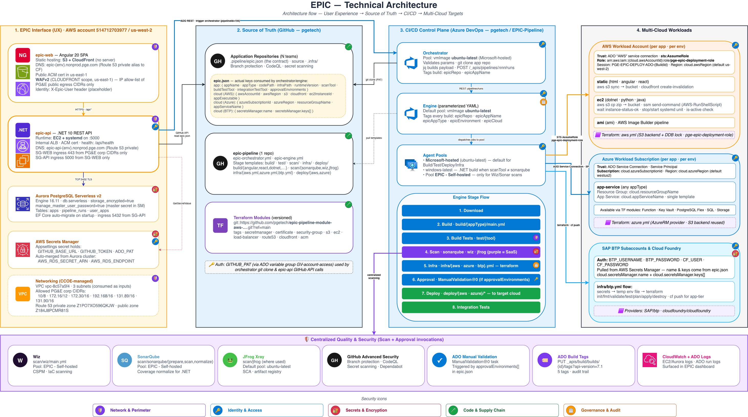
EPIC: Enterprise Pipeline for Infrastructure and Cloud
High-Level Architecture Diagram
Notes:
Pre-read

Slide 9

EPIC: Enterprise Pipeline for Infrastructure and Cloud
Concerns / Follow-Ups
Are there any concerns with the architecture that you would like to have a follow-up conversation with the Solution Architect?
Speak up now (or added it to the chat) so that we can follow up on your concerns after this session concludes.

Slide 10

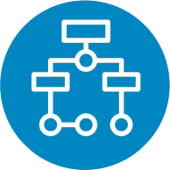

EPIC Peer Review: APP-2102 – ADO Pipeline
Appendix: Resources
Project Documentation:
EPIC Repo: https://github.com/pgetech/epic-pipeline
Key Contacts:
Travis Hayes: TAHZ@pge.com
Robb Morgan: RHMG@pge.com
Project Documentation
High-Level Architecture
Project Contacts
Place links to your project documentation here
Place a link to your Lucid Diagram of your HLA here. (Sharing for the link should be for all licensed users at PG&E an should include Comment rights)
Place your key project contacts here

